Slide 1
Visualize Your Connections: A Practical Guide to Power BI Graphs
xxx
Jake Duddy

Slide 2




evaluationcontext.github.io/
linkedin.com/in/jakeduddy/

Slide 3
Scanner API

Slide 4


Scanner API
Scanner API
Workspaces, Items and metadata
workspaces
Graph API
User Groups and Members
users
reports
How do we structure and visualize who has access to each Fabric Items?
users
datasets
users
tables
columns
measures
…
…
https://evaluationcontext.github.io/posts/graphframes/

Slide 5
Graph Theory

Slide 6
Graph Theory
Representation of relationships between entities
G = (V, E)
V = Vertices
{A, B, C, D, E, F, G}
E = Edges
(u, v) or (src, dst)
{(A,B), (B,C), (C,D), (D,E), (E,F), (F,A), C,F), (E,G)}
A
F
B
E
G
C
D

Slide 7
Terminology
Unidirectional
Directed Cyclic
Directed Acyclic (DAG)
1
Friend
10
7
Boss
2
12
5
3
Friend
5
Colleague
Trees
Weighted
Attributes

Slide 8
Adjacency matrix
Poor compression when considering sparse graphs, better for dense
 | A | B | C | D | E | F | G
A | 0 | 1 | 0 | 0 | 0 | 1 | 0
B | 1 | 0 | 1 | 0 | 0 | 0 | 0
C | 0 | 1 | 0 | 1 | 0 | 1 | 0
D | 0 | 0 | 1 | 0 | 1 | 0 | 0
E | 0 | 0 | 0 | 1 | 0 | 1 | 1
F | 1 | 0 | 1 | 0 | 1 | 0 | 0
G | 0 | 0 | 0 | 0 | 1 | 0 | 0
A
F
B
E
G
C
D

Slide 9
Adjacency List
Good for sparse graphs, few edges
A | (B, F)
B | (A, C)
C | (B, D, F)
D | (C, E)
E | (D, F, G)
F | (A, E)
G | (E)
A
F
B
E
G
C
D

Slide 10
Node and Edges
Nodes
A
B
C
D
E
F
G
Edges
src | dst
A | B
B | A
B | C
C | B
… | …
G | E
A
F
B
E
G
C
D

Slide 11
Triplets
A lot of graph processing involves calculating triplets
Tabular, well suited for Power BI
Vertices
A
B
C
D
E
F
G
Edges
src | dst
A | B
B | A
B | C
C | B
… | …
G | E
A
F
B
E
G
C
D

Slide 12
User Permissions

Slide 13
Graph Properties
Directed
Non-weighted
Attributes
Role Type [Admin, Member..]
Possibly Cyclic (groups)
workspaces
users
reports
Show scanner API schema like nested entireties in tom. The highlight different nodes for users and group. Then show how group to group to user. Get then build graph
Pregel to disseminate permission in strict
Then expand struct
Get nodes and edges for David's image
Mention filtering nodes is troublesome
Go to triplet form with filtering in vega
Much easier Dax to trim the graph
users
datasets
users
tables
columns
measures
…
…
https://evaluationcontext.github.io/posts/graphframes/

Slide 14
Deneb
How does solution work
Here or later?
Mention triplet form easier for filtering nodes
Start by mentioning graph outcomes?
Easiy filtering etc?

Slide 15
GraphFrames & Pregel
Graphframes
Pregel
SQL recursive query.l, but not supported the pyspark sql
But can also then do graph algos mention a few and then show label propagation
G = (V,E)
https://evaluationcontext.github.io/posts/graphframes/

Slide 16
GraphFrames & Pregel
# vertices # +-------------------------------------------------------------------------------------------------------------------+ # | id | nodeId | type | accessRight | # +-------------------------------------------------------------------------------------------------------------------+ # | a2cc72b4-50e8-4c78-b875-6b1d6af6f04fAdmin | a2cc72b4-50e8-4c78-b875-6b1d6af6f04f | workspace | Admin | # | c6434512-6cec-45d6-91a0-e24d6ec8ae3fContributor | c6434512-6cec-45d6-91a0-e24d6ec8ae3f | workspace | Contributor | # | 18f3f38d-d4e5-4861-9633-43c87cd6f444 | 18f3f38d-d4e5-4861-9633-43c87cd6f444 | group | | # +-------------------------------------------------------------------------------------------------------------------+ # edges # +-------------------------------------------+--------------------------------------+------------+ # | src | dst | edge_type | # +-------------------------------------------+--------------------------------------+------------+ # | a2cc72b4-50e8-4c78-b875-6b1d6af6f04fAdmin | 27600b6f-6556-43ad-98de-9a6e068a8500 | admin | # | 32282557-43f0-4182-9541-d9f3c44029c6 | bba07815-4eaf-4798-bc76-f7e55747cb3b | | # | a9497daf-95e4-42aa-9edf-658edeb2205d | ccb5abe8-8890-49a4-a8fc-d3bc2c3821b" | | # +-------------------------------------------+--------------------------------------+------------+
https://evaluationcontext.github.io/posts/graphframes/

Slide 17
GraphFrames & Pregel
# +-------------------------------------------+--------------------------------------------------------------------------------------------------------------+---------------------------------------+-----------+--------------+ # | id | resolved_roots | nodeId | type | accessRight | # +-------------------------------------------+--------------------------------------------------------------------------------------------------------------+---------------------------------------+-----------+--------------+ # | 94c3fe39-0ed5-4eeb-a230-2e444638930fAdmin | ["{\"type\":\"workspace\", \"id\":\"94c3fe39-0ed5-4eeb-a230-2e444638930f\",\"accessRight\":\"Member\"}"] | 94c3fe39-0ed5-4eeb-a230-2e444638930f | workspace | Contributor | # | 5de589b4-f539-468d-96c8-7fd1034faf9e | ["{\"type\":\"workspace\", \"id\":\"31633c8d-6cac-4738-b6f3-f63ebbf29ea0\",\"accessRight\":\"Viewer\"}",.."] | 5de589b4-f539-468d-96c8-7fd1034faf9e | user | null | # +-------------------------------------------+--------------------------------------------------------------------------------------------------------------+---------------------------------------+-----------+--------------+
https://evaluationcontext.github.io/posts/graphframes/

Slide 18
GraphFrames & Pregel
accessToObject
accessToObjectEdges
https://evaluationcontext.github.io/posts/graphframes/

Slide 19
Graphs in Power BI
Custom visuals
Deneb
Force directed and beeswarm
Tree layout possible in this case since 1-many but force directed gives a bit more flexibility
https://evaluationcontext.github.io/posts/deneb-force-directed/

Slide 20
This solution is setup for item -> user
To better trim the graph edges from from user -> item and user -> group -> item are required
Can’t remove groups that aren’t in the direct path when select specific user
Power bi has sideways recursion but no recursion, need to pre-calc paths for filtering
Python and R
limitations
Should be possible to create a KQL database, create graph, setup motif and use dynamic parameters to return trimmed graph
Not got a working demo
In this case you still want the triplet form to feed into deneb

Slide 21
DAX Query Plan

Slide 22
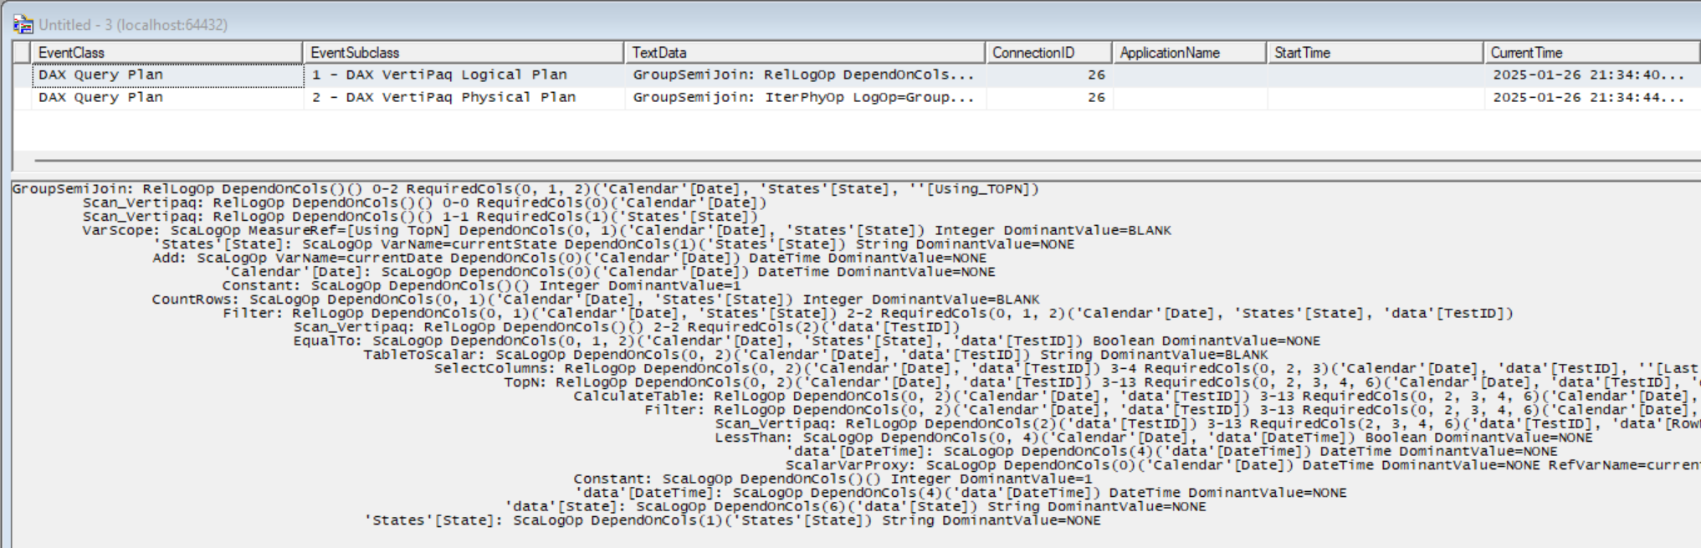
DAX Query Plan
Each increase in indent represents a nested operation

Slide 23
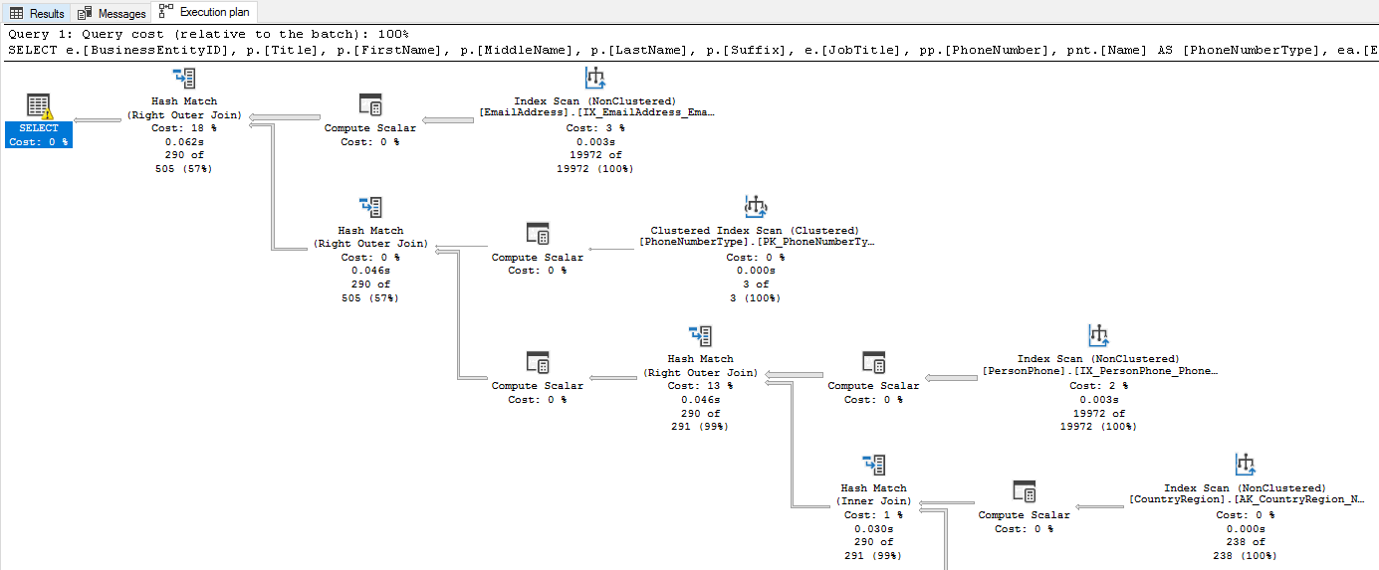
SQL Server Query Plan
https://learn.microsoft.com/en-us/sql/relational-databases/performance/display-an-actual-execution-plan?view=sql-server-ver16

Slide 24
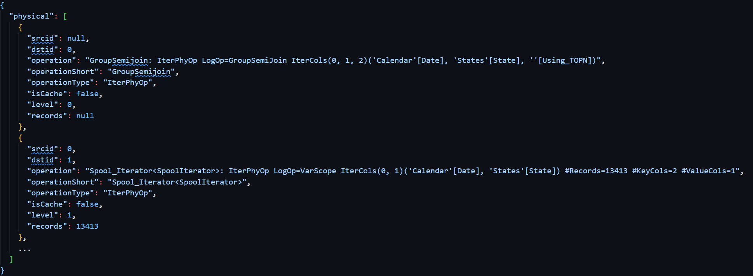
DAX Query Plan To Graph
Parse XML to dict
Split indents to generate Physical and Logical Plans Graphs
https://evaluationcontext.github.io/posts/query-plan-graph/

Slide 25
Deneb
Xxx
Beeswarm

